Slide 2
Table of Contents
Introduction
Problem Statement
Requirements
Use Case Diagram
Case Description
Activity Diagram
Sequence Diagram
Class Diagram
ER Diagram
Conclusion
References

Slide 3
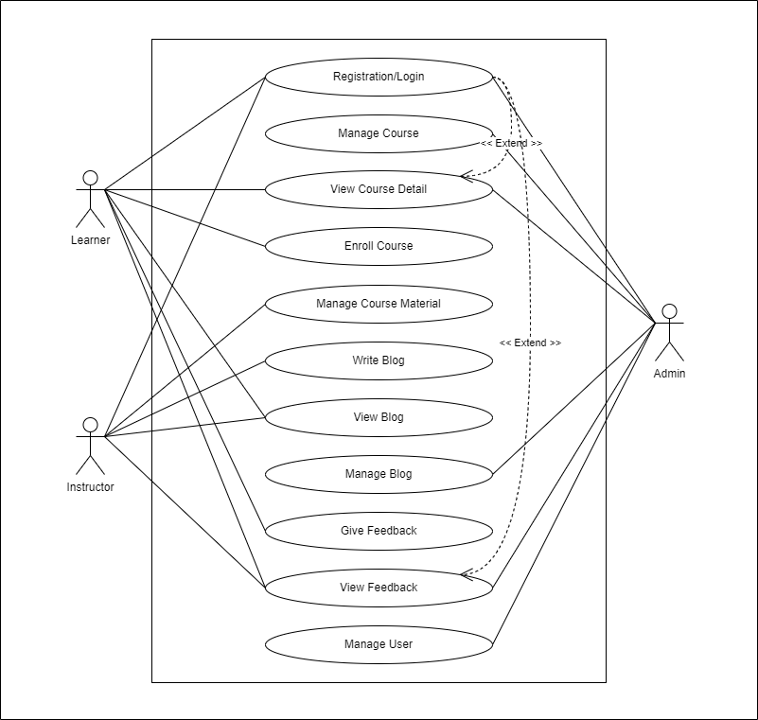
Use Case Diagram

Slide 4
Use Case Description
Use Case ID | UC-01
Use Case Name | Registration/Login
Actor | All users (Learners, Instructors, admins)
Description | Users (learners, instructors, admins) can register for the system and log in to access their accounts.
Precondition | User is not logged in.
Trigger | User accesses the system.
Flow of Events | User selects the "Register" option. User provides registration details (name, email, username, password). User submits the registration form. User receives a confirmation email. User selects the "Login" option. User enters their username and password. User clicks "Login."
Postcondition | User is logged in and can access their account.
Use Case ID | UC-02
Use Case Name | Manage Course
Actor | Admin
Description | Admins can create, edit, and delete courses in the system.
Precondition | Admin is logged in.
Trigger | Admin selects the course management option.
Flow of Events | Admin selects "Create Course" to add a new course. Admin enters course details and Admin clicks "Create." Admin selects an existing course to edit. Admin modifies course details. Admin clicks "Save Changes." Admin selects a course to delete. Admin confirms deletion.
Postcondition | Course management is updated according to admin actions.

Slide 5
Use Case Description
Use Case ID | UC-03
Use Case Name | View Course Detail
Actor | All Users
Description | All users can view details of a course, including its title, description, and instructor.
Precondition | User is logged in.
Trigger | User selects a course to view.
Flow of Events | User navigates to the course details page. User selects a course to view.
Postcondition | User can see the details of the selected course.
Use Case ID | UC-04
Use Case Name | Manage Course Material
Actor | Instructor
Description | Instructors can add, edit, and delete course materials for the courses they teach.
Precondition | Instructor is logged in.
Trigger | Instructor selects the course material management option.
Flow of Events | Instructor selects "Add Material" for a course. Instructor uploads course material and Instructor clicks "Add." Instructor selects an existing material to edit. Instructor modifies material details. Instructor clicks "Save Changes." Instructor selects a material to delete.
Postcondition | Course materials are updated according to instructor actions.

Slide 6
Use Case Description
Use Case ID | UC-05
Use Case Name | Enroll Course with Payment
Actor | Learner
Description | Learners can enroll in courses by making payments for the chosen courses.
Precondition | Learner is logged in.
Trigger | Learner selects a course to enroll in.
Flow of Events | Learner selects a course to enroll in. Learner proceeds to payment. Learner provides payment details and confirms payment.
Postcondition | Learner is enrolled in the selected course upon successful payment.
Use Case ID | UC-06
Use Case Name | Write Blog
Actor | Instructor
Description | Instructors can create and publish blog posts.
Precondition | Instructor is logged in.
Trigger | Instructor selects the "Write Blog" option.
Flow of Events | Instructor enters blog post content (title, content). Instructor clicks "Publish."
Postcondition | The blog post is published and visible to all users.

Slide 7
Use Case Description
Use Case ID | UC-07
Use Case Name | View Blog
Actor | All Users
Description | All users can view blog posts created by instructors.
Precondition | User is logged in.
Trigger | User selects a blog post to view.
Flow of Events | User navigates to the blog post. User selects a blog post to view.
Postcondition | User can see the content of the selected blog post.
Use Case ID | UC-08
Use Case Name | Manage Blog
Actor | Admin
Description | Admins can edit and delete blog posts created by instructors.
Precondition | Admin is logged in.
Trigger | Admin selects the blog management option.
Flow of Events | Admin selects a blog post to edit. Admin modifies the blog post content. Admin clicks "Save Changes." Admin selects a blog post to delete. Admin confirms deletion.
Postcondition | Blog posts are updated or removed according to admin actions.

Slide 8
Use Case Description
Use Case ID | UC-09
Use Case Name | Give Feedback
Actor | Learner
Description | Learners can provide feedback on courses in which they are enrolled.
Precondition | Learner is logged in and enrolled in at least one course.
Trigger | Learner selects a course to provide feedback.
Flow of Events | Learner selects a course to provide feedback. Learner enters feedback comments and ratings (if applicable). Learner submits the feedback.
Postcondition | Learner's feedback is recorded for the selected course.
Use Case ID | UC-10
Use Case Name | View Feedback
Actor | All Users
Description | All users can view feedback provided by learners for specific courses.
Precondition | User is logged in.
Trigger | User selects a course to view feedback.
Flow of Events | User navigates to the course feedback section. User selects a course to view feedback.
Postcondition | User can see feedback comments and ratings for the selected course.

Slide 9
Use Case Description
Use Case ID | UC-11
Use Case Name | Manage User
Actor | Admin
Description | Admins can manage user accounts, including creating, editing, and deleting user profiles.
Precondition | Admin is logged in.
Trigger | Admin selects the user management option.
Flow of Events | Admin selects "Create User" to add a new user. Admin enters user details (name, email, role). Admin clicks "Create." Admin selects an existing user to edit. Admin modifies user details. Admin clicks "Save Changes." Admin selects a user to delete. Admin confirms deletion.
Postcondition | User management is updated according to admin actions.

Slide 10
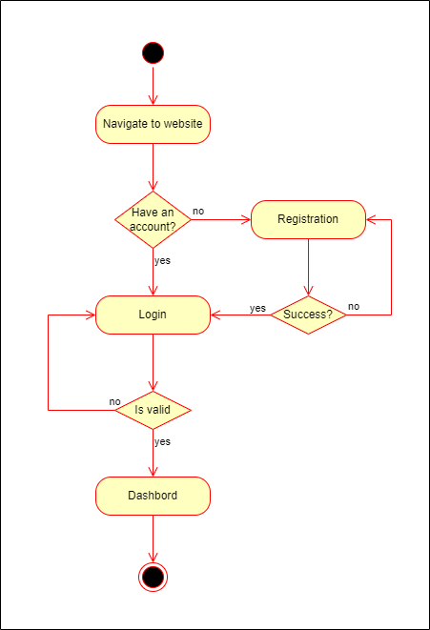
Activity Diagram (Registration/Login)

Slide 11
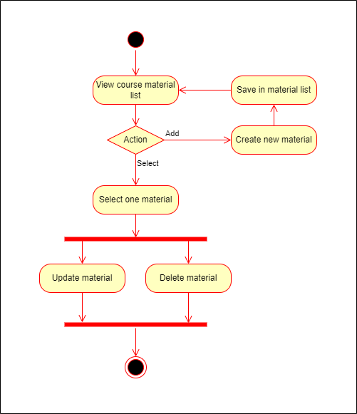
Activity Diagram (Manage Course)

Slide 12
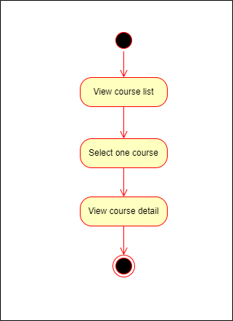
Activity Diagram (View Course Detail)

Slide 13
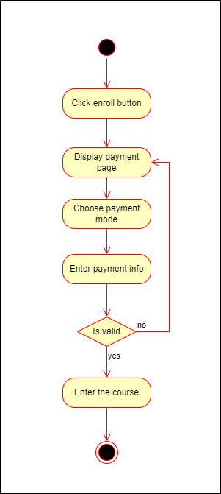
Activity Diagram (Enroll Course)

Slide 14
Activity Diagram (Enroll Course)

Slide 15
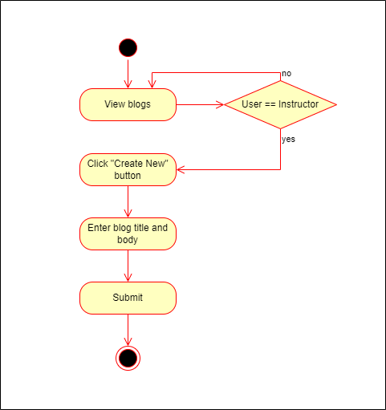
Activity Diagram (Write Blog)

Slide 16
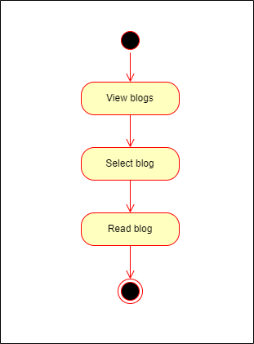
Activity Diagram (View Blog)

Slide 17
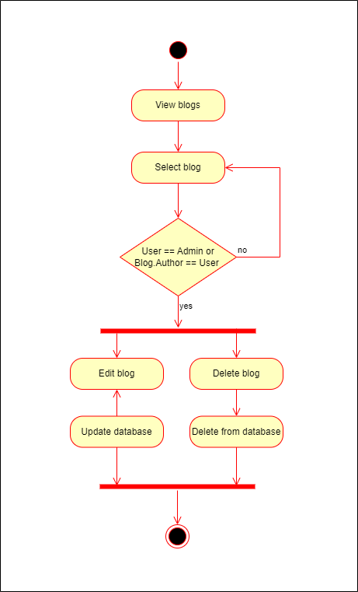
Activity Diagram (Manage Blog)

Slide 18
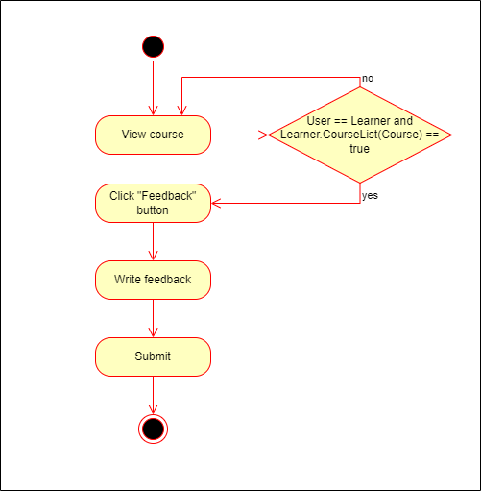
Activity Diagram (Give Feedback)

Slide 19
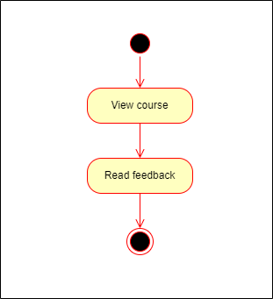
Activity Diagram (View Feedback)

Slide 20
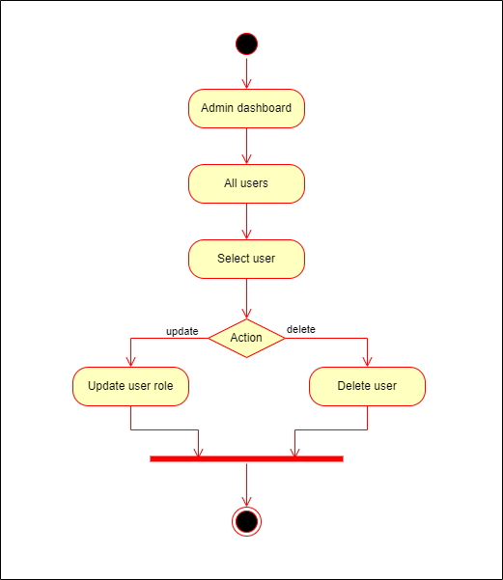
Activity Diagram (Manage Users)

Slide 21
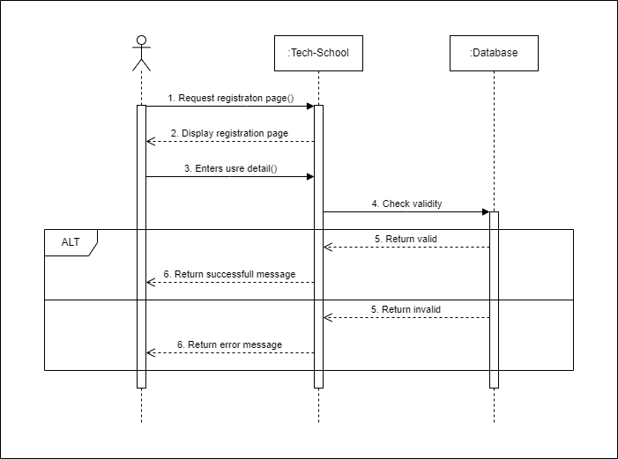
Sequence Diagram (Registration/Login)

Slide 22
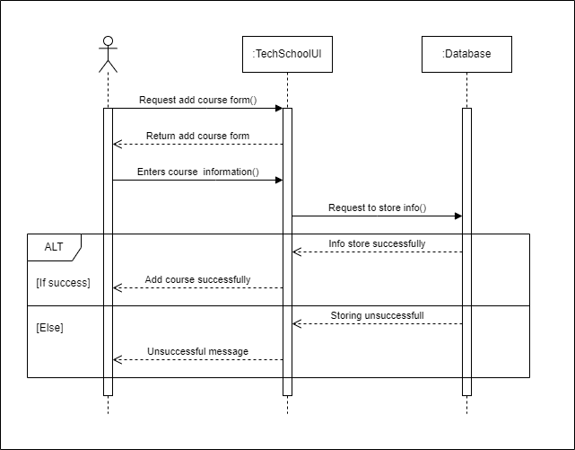
Sequence Diagram (Add Course)

Slide 23
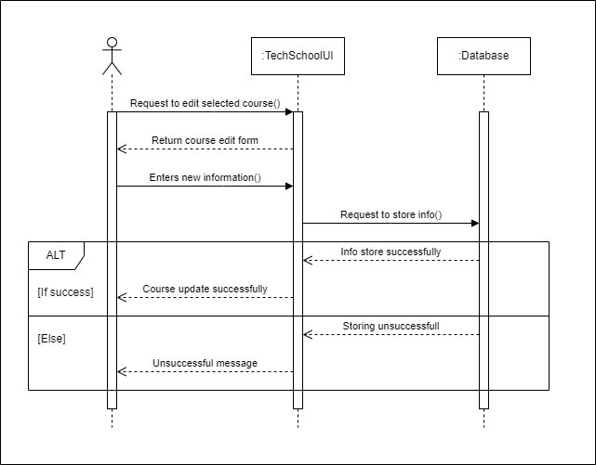
Sequence Diagram (Edit Course)

Slide 24
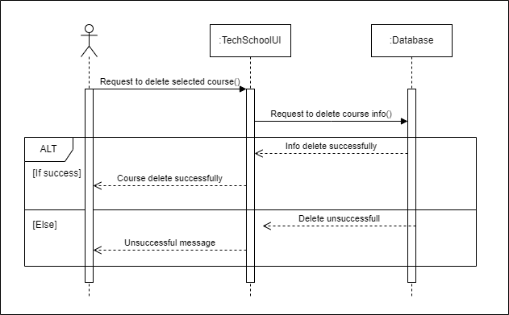
Sequence Diagram (Delete Course)

Slide 25
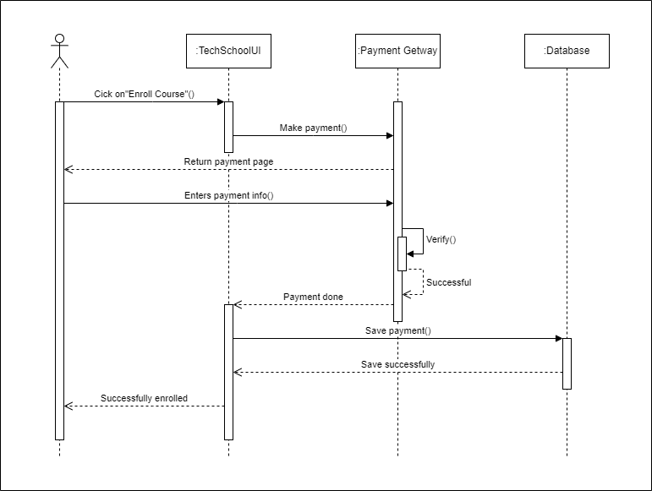
Sequence Diagram (Enroll Course)

Slide 26

Sequence Diagram (Add Course Material)

Slide 27

Sequence Diagram (Edit Course Material)

Slide 28

Sequence Diagram (Delete Course Material)

Slide 29
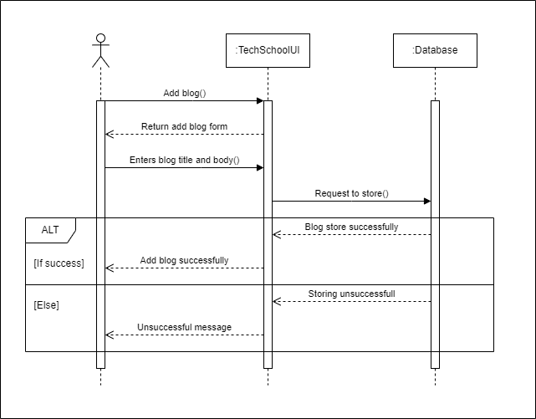
Sequence Diagram (Add Blog)

Slide 30

Sequence Diagram (Edit Blog)

Slide 31
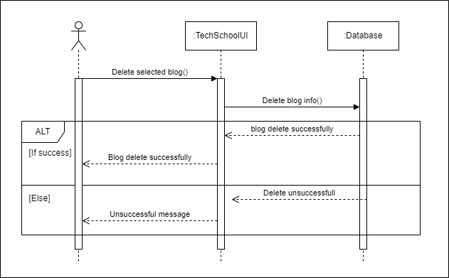
Sequence Diagram (Delete Blog)

Slide 32
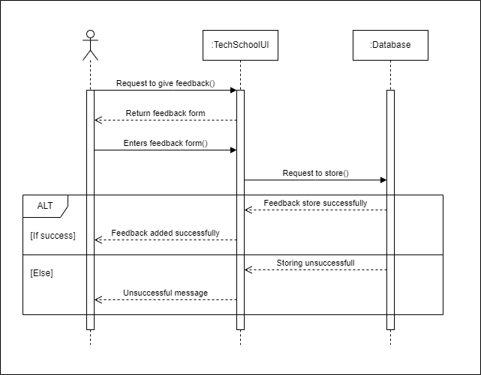
Sequence Diagram (Add Feedback)

Slide 33

Sequence Diagram (User Removal)

Slide 34
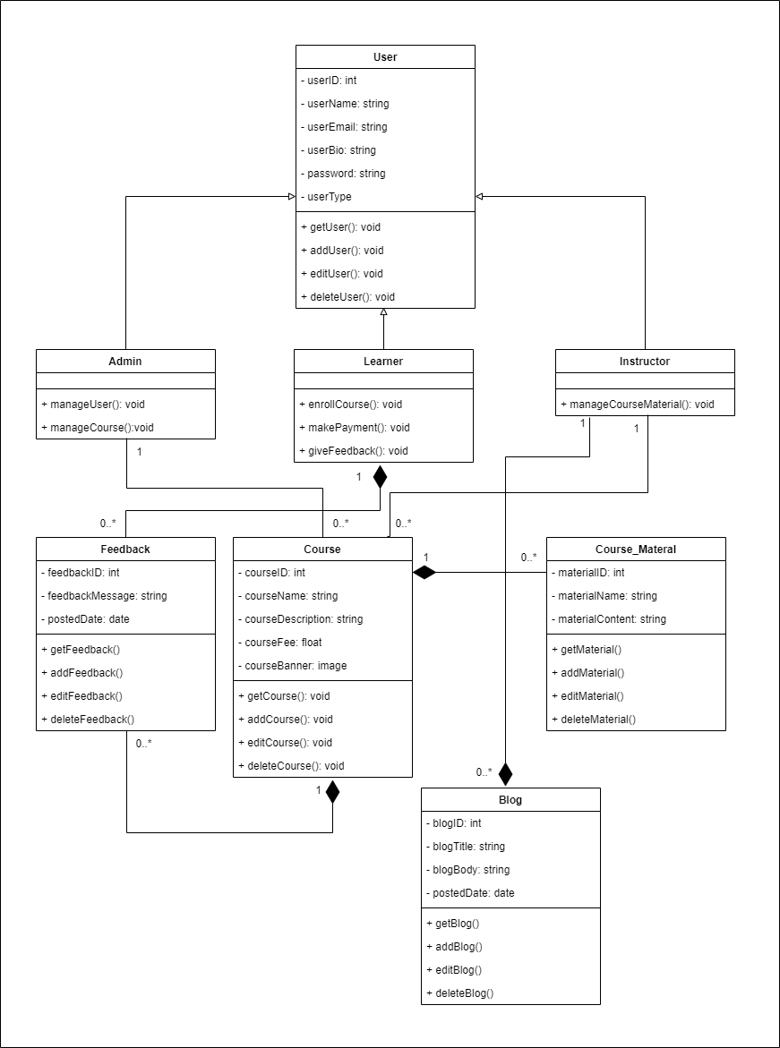
Class Diagram

Slide 35
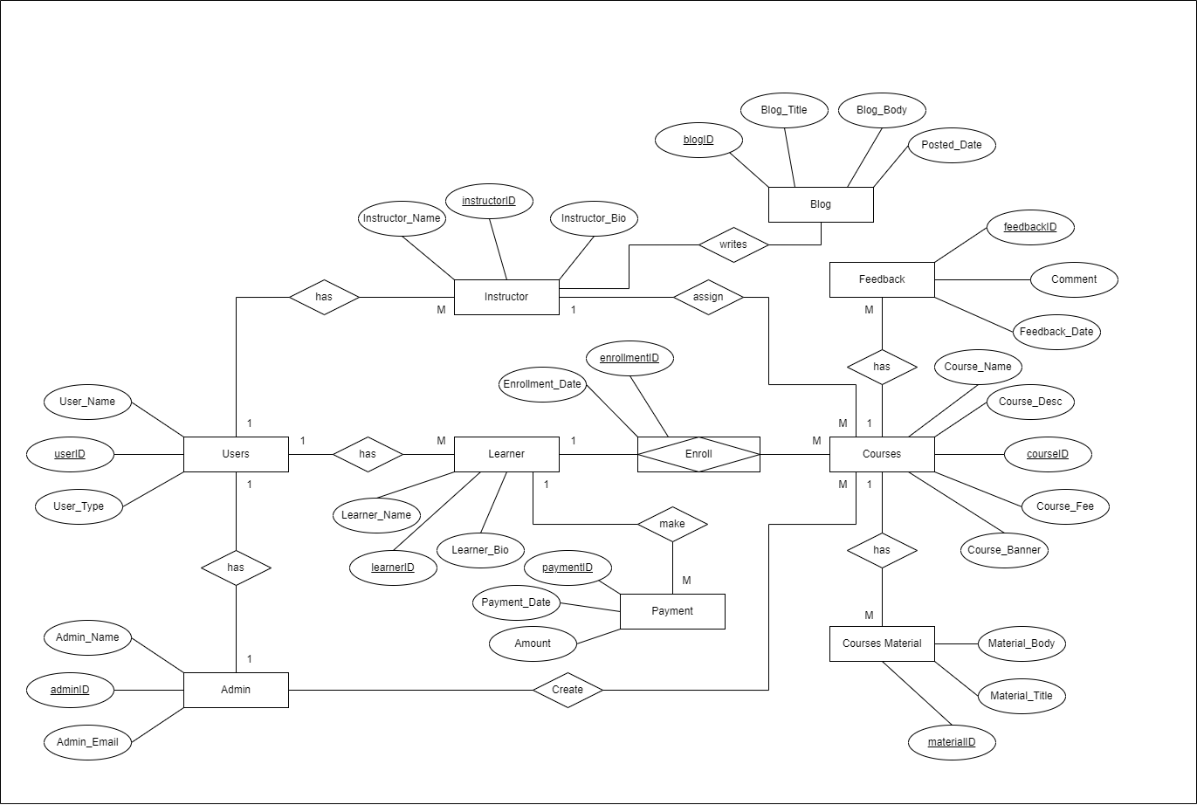
ER Diagram

